Slide 1
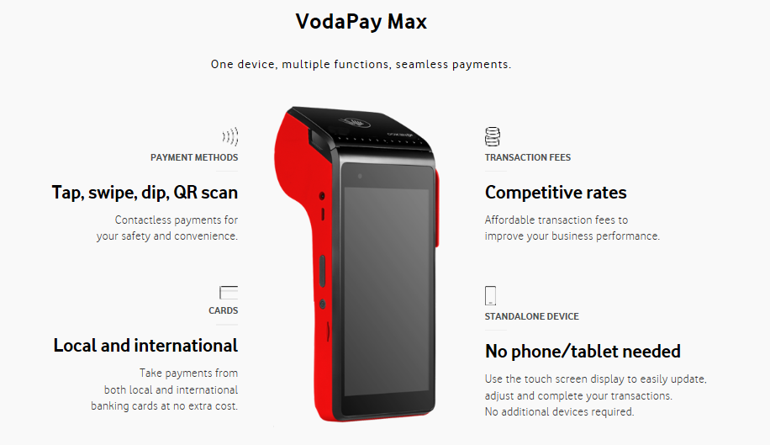


R270/month rental (R310.50 incl vat)
Includes Free Insurance
Free Delivery
No Set-up Costs
No Minimum Service Fees

Slide 2
R270/month rental (R310.50 incl vat)
Includes Free Insurance
Free Delivery
No Set-up Costs
No Minimum Service Fees
Supporting documents | Sole Prop | Pty Ltd/Inc/CC*
Valid Identity Document Clear Copy | Copy of RSA ID (SA Citizens) Copy of Passport (foreign nationals) Copy of Asylum Certificate (foreign nationals | Only for the authorised director
Proof of bank Account Less than 3 month old | In the name of shop owner | In the registered company name
Business work permit Not expired | Only for Foreign Nationals | Only if Director is Foreign National
*Signed Resolution is needed (the sales Rep will provide letter to sign)

